Slide 1

METABET
UNCOVERING PREDICTION MARKET WHALES

Slide 2

The Signal in the Noise
Prediction markets are flooded with speculation. Finding genuine alpha requires distinguishing luck from skill.

Slide 3

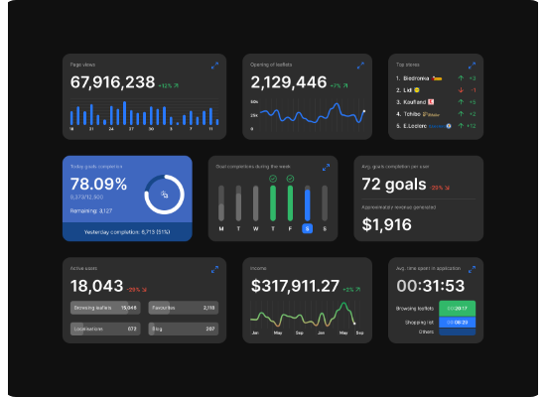
Intelligent Analytics Platform
Data-Driven Discovery
MetaBet is designed to identify, validate, and track the most successful participants in prediction markets like Polymarket.
Instead of following the crowd, our system uses rigorous data analysis to uncover "Whales"—traders with exceptional, proven track records of success.

Slide 4

Stage 1: Social Discovery
Alpha often starts with a signal.
MetaBet scans social media ecosystems, including Twitter and LinkedIn, to identify potential market participants who share insights or claim positions.
This wide-net approach captures the "soft data" of market sentiment before rigorous validation begins.

Slide 5






Stage 2: Rigorous Validation
Win Rate
Profit/Loss Ratio
Consistency
We target a sustainable win rate of >80% over a significant volume of bets to filter out lucky streaks.
Analyzing the risk-reward profile to ensuring gains significantly outweigh losses over time.
Tracking performance across different market conditions to prove skill is not domain-dependent.

Slide 6
The MetaBet Standard
Defining Excellence
80%
In a binary market, a 50% win rate is a coin flip. To be classified as a "Whale" in our ecosystem, a trader must demonstrate statistical significance well beyond random chance.
This high threshold ensures that the alpha we generate is based on genuine insight and edge.
MINIMUM WIN RATE

Slide 7


Whale Detection Engine
Automated Expert Discovery
Our system uses automated algorithms to map betting histories against specific domains (e.g., Politics, Economics, Tech).
By distinguishing between generalists and specialists, MetaBet creates a curated database of proven winners, allowing users to follow the "smart money" in specific sectors.

Slide 8
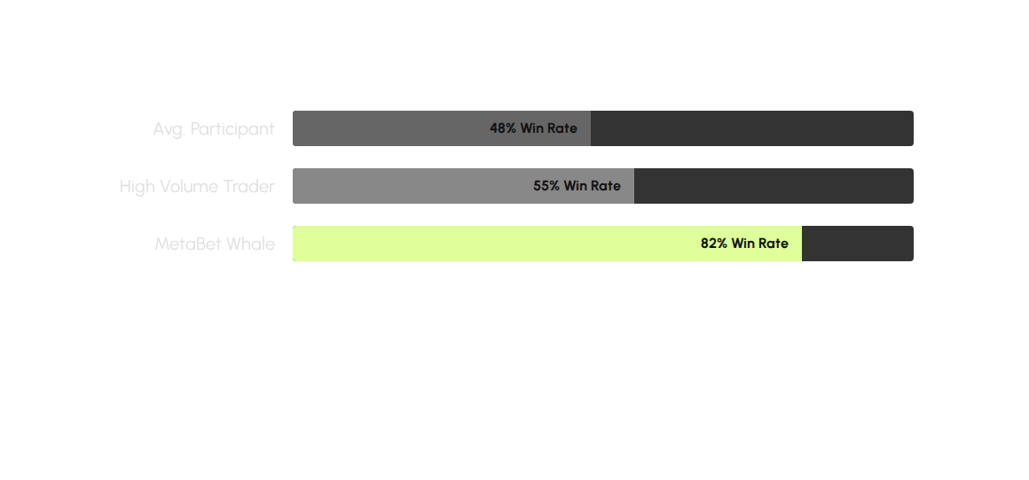
Luck vs. Skill: A Comparison
MetaBet strictly validates history to isolate the top percentile of performers.

Slide 9

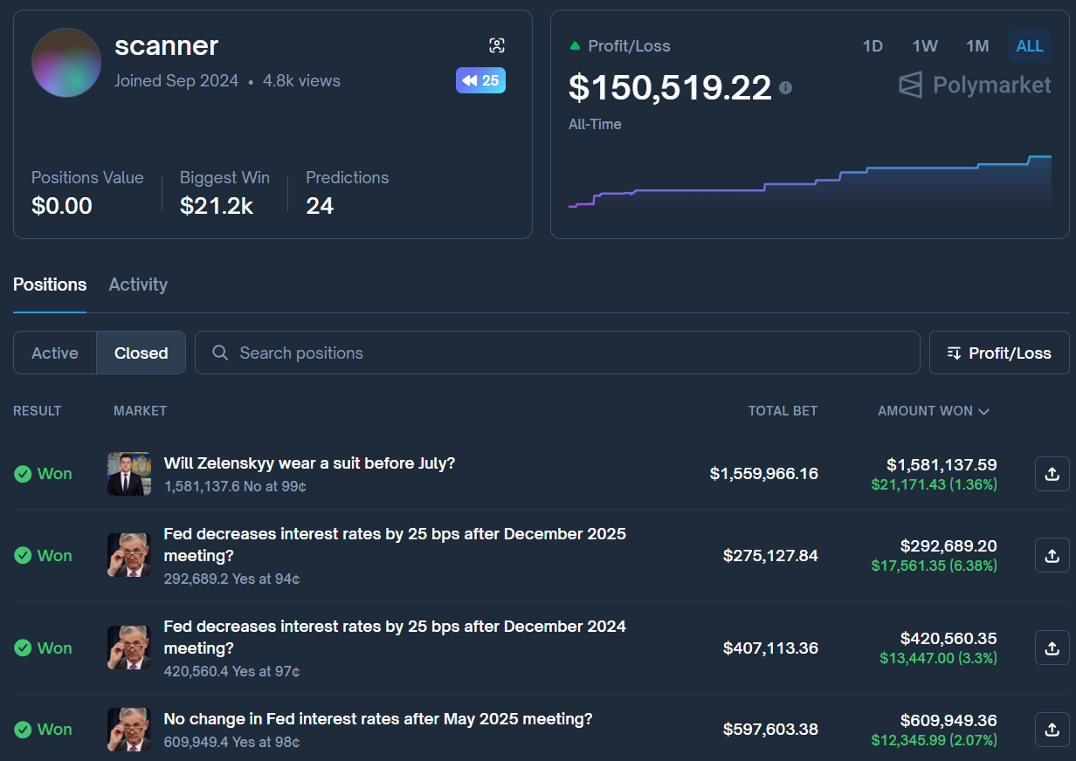

Slide 10
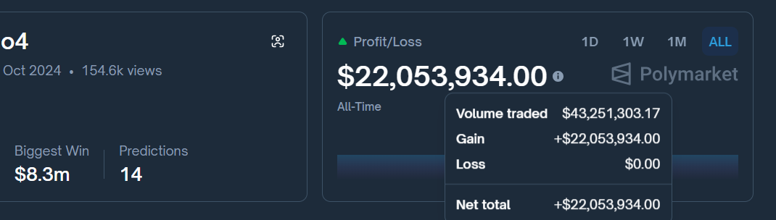
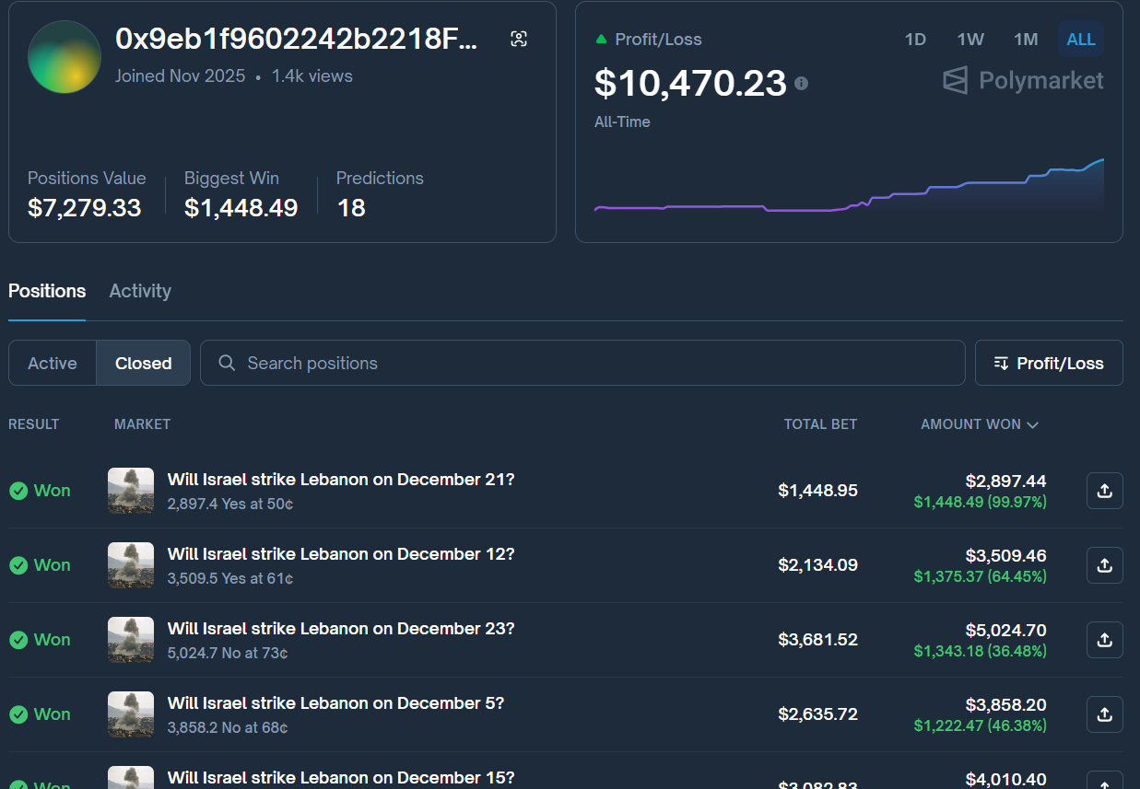

Slide 11
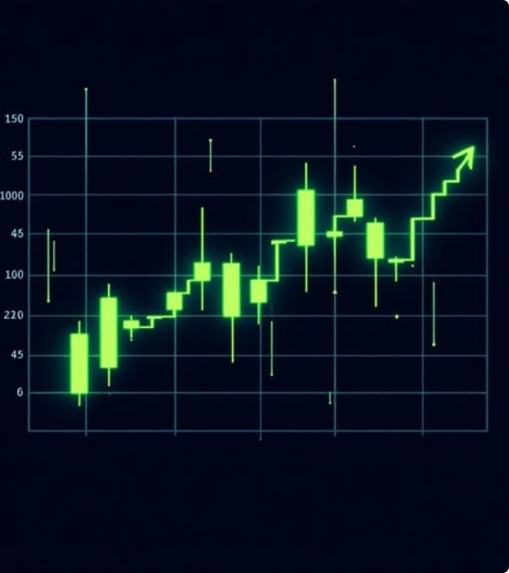
Active Bet Monitoring
Validation is just the beginning.
Once a Whale is identified, MetaBet initiates continuous tracking. New positions taken by validated experts trigger real-time alerts.
This allows users to act on information immediately, mirroring the moves of the market's most successful players.

Slide 12






System Architecture
Discovery
Validation
Alerts
Scanning social & market data.
Rigorous performance checks.
Real-time position tracking.

Slide 13
"
"MetaBet helps users discover genuine alpha by finding traders with exceptional track records."
— The MetaBet Mission

Slide 14
Questions?
Navigate the prediction economy with confidence.

